Slide 1


Image Processing and Machine Vision
Vivekanand Education Society's Institute of Technology
An Autonomous Institute Affiliated to University of Mumbai
Development of convolution algorithm without using standard function
Group No. : 11
1 Siddharth Dangi (D14/15)
2 Manish Mhatre (D14/33)
3 Ganesh Patil (D14/44)
4 Rushikesh Sarak (D14/53)

Slide 2
Contents to be covered
Problem Statement
Literature Survey
Proposed Solution
Complete Block Diagram
Flowchart
Observations/Results
Conclusion
References

Slide 3
Problem Statement
The task is to develop a custom image processing algorithm that encompasses three major functions: edge detection, blurring, and sharpening. The challenge is to create a program that accepts an input image and, through a series of well-defined steps, produces three distinct outcomes: an image with highlighted edges, a blurred version for noise reduction, and a sharpened rendition for enhanced clarity.

Slide 4
Literature Survey
Sr. No. | Title of Technical paper | Name of Author | Year of publication | Name of Journal | Methodology | Results/ conclusions | Drawbacks/ limitations
1 | Fusion of Panchromatic and Multispectral Images Using Multiscale Convolution Sparse Decomposition | Kai Zhang, Yeudo Tau, Jiande Sun | 2020 | IEEE Journal of Selected Topics in Applied Earth Observations and Remote Sensing ( Volume: 14) | At each scale, the sparse codes are combined using an injection model that merges high frequency details from panchromatic image with low frequency information from multispectral image.. | The proposed technique was tested on multiple satellite image datasets with different sensors. accuracy was high. Both spatial and spectral quality of fused images were evaluated using metrics. | The method has higher computational complexity due to multiscale convolutional sparse coding. Spatial distortion may occur in some fused images.

Slide 5
Literature Survey
Sr. No. | Title of Technical paper | Name of Author | Year of publication | Name of Journal | Methodology | Results/ conclusions | Drawbacks/ limitations
2 | Kriging-Weighted Laplacian Kernels for Grayscale Image Sharpening | Lijie Zhou Weihui Yu | 2022 | IEEE Access( Volume: 10) | For each pixel in the input grayscale image, compute the responses of multiple Laplacian filters of different sizes in the neighborhood around that pixel. | Sharpness metrics, such as edge strength, gradient magnitude, or other sharpness measures, are calculated on standard test images before and after sharpening. | kriging interpolation and adaptive weighting of multiple Laplacian filter responses can be computationally intensive, especially for larger image sizes or neighborhoods.

Slide 6
Proposed Solution
Create a custom image processing algorithm utilizing convolution without standard functions.
Implementing Sobel, Gaussian, and sharpening kernels enables edge detection, blurring for noise reduction, and sharpening for clarity.
The algorithm iterates through pixels, extracting regions, and applying specific convolution operations to achieve distinct visual enhancements.
Displaying the original and processed images demonstrates the versatility of the algorithm across edge detection, blurring, and sharpening tasks.

Slide 7
Basic Convolution
In practical way, an Image Convolution is simply an element-wise multiplication of two matrices followed by a sum.
Take two matrices (which both have the same dimensions).
Multiply them, element-by-element (i.e., not the dot-product, just a simple multiplication).
Sum the elements together.

Slide 8
The process of image convolution
A convolution is done by multiplying a pixel’s and its neighboring pixels color value by a matrix.
Kernel: A kernel is a (usually) small matrix of numbers that is used in image convolutions.
Differently sized kernels containing different patterns of numbers produce different results under convolution.
The size of a kernel arbitrary but 3x3 is often used
0 | 1 | 0
1 | 1 | 1
0 | 1 | 0

Slide 9
Why convolve an image?
Smooth
Sharpen
Intensify
Enhance

Slide 10
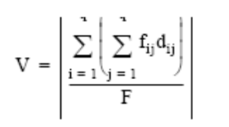
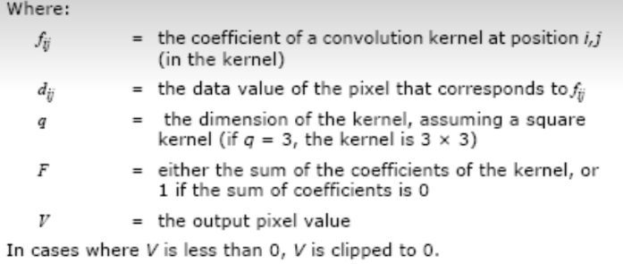
Convolution Formula

Slide 11
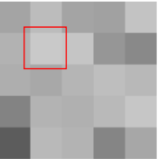
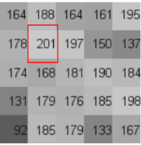
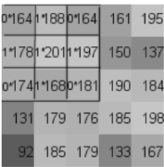
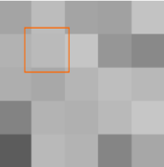
Example
Original image Image with color Image with 3x3 Output Image
values placed kernel placed
over it over it
Divided by the sum of the kernel
x 932/5 = new pixel color
164 | 188 | 164
178 | 201 | 197
174 | 168 | 181
0 | 1 | 0
1 | 1 | 1
0 | 1 | 0

Slide 12
Simple Example for Basic Understanding
Input Kernel Output
4 | 3 | 7 | 2 | 1
5 | 8 | 9 | 3 | 2
1 | 6 | 5 | 2 | 8
9 | 2 | 3 | 4 | 7
3 | 1 | 6 | 8 | 5
0 | -1 | 0
-1 | -5 | -1
0 | -1 | 0
7 | 2 | 16 | -4 | -3
-1 | 33 | 18 | 4 | 2
-9 | 10 | 11 | -1 | 12
19 | 0 | 2 | 8 | 14
1 | -6 | 13 | 20 | 11

Slide 13
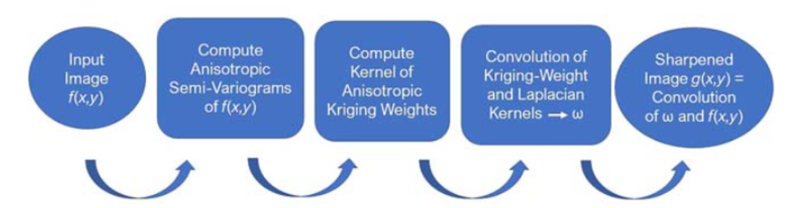
Complete Block Diagram of Proposed System:

Slide 14
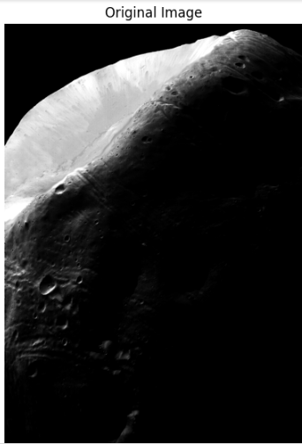
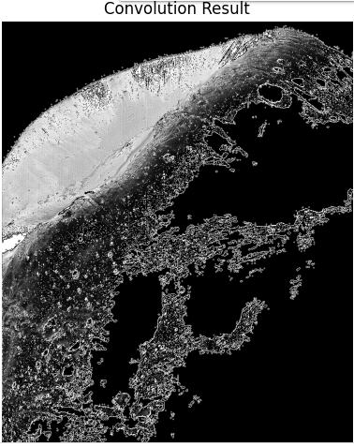
Observations / Results
Sharpening of an Image

Slide 15
Conclusion
We have successfully developed the convolution algorithm which takes gray intensity level of input image in 8x8 matrix and perform elementwise multiplication to every pixel.Further adding all values to single value and storing in blank 8x8 matrix.The convolution algorithm is the basic algorithm used for various image operations like sharpening, smoothing, averaging, erosion and dilation.

Slide 16
References
[1] K. Zhang, F. Zhang, Z. Feng, J. Sun and Q. Wu, "Fusion of Panchromatic and Multispectral Images Using Multiscale Convolution Sparse Decomposition," in IEEE Journal of Selected Topics in Applied Earth Observations and Remote Sensing, vol. 14, pp. 426-439, 2021
[2]T. D. Pham, "Kriging-Weighted Laplacian Kernels for Grayscale Image Sharpening," in IEEE Access, vol. 10, pp. 57094-57106, 2022

